Slide 1
ZIPSERVE PAYPERS PACKET HOW TO GUIDE

Slide 2
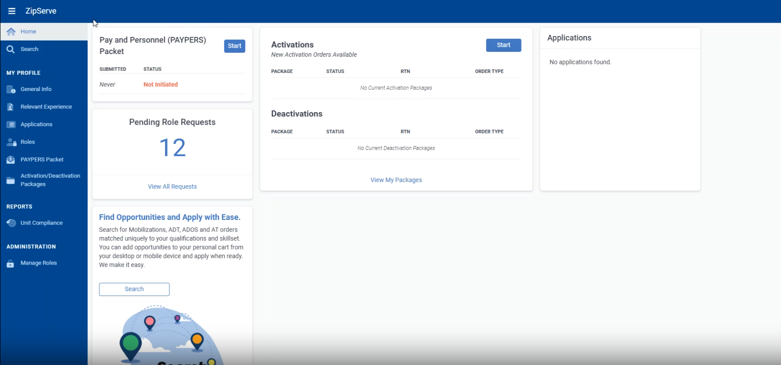
Step 1: Go to Quick Links and click the ‘U.S. Navy Reserve Zipserve’ link:

Slide 3

Step 2: Click the Start Button

Slide 4
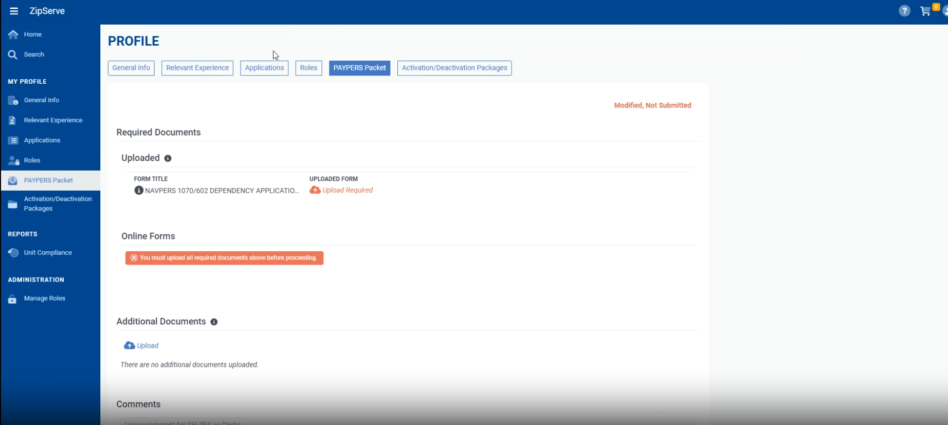
Step 3: Upload signed NAVPERS 1070/602 to the red ‘UPLOAD REQUIRED’ link.
NOTES
The uploaded NAVPERS 1070/602 (available via NSIPS) will need to have an approver signature at the bottom. If you do not have a 1070/602 available in NSIPS you will need to route one for approval using the How-to guide.
Prior to submission ensure the form has a signature.

Slide 5
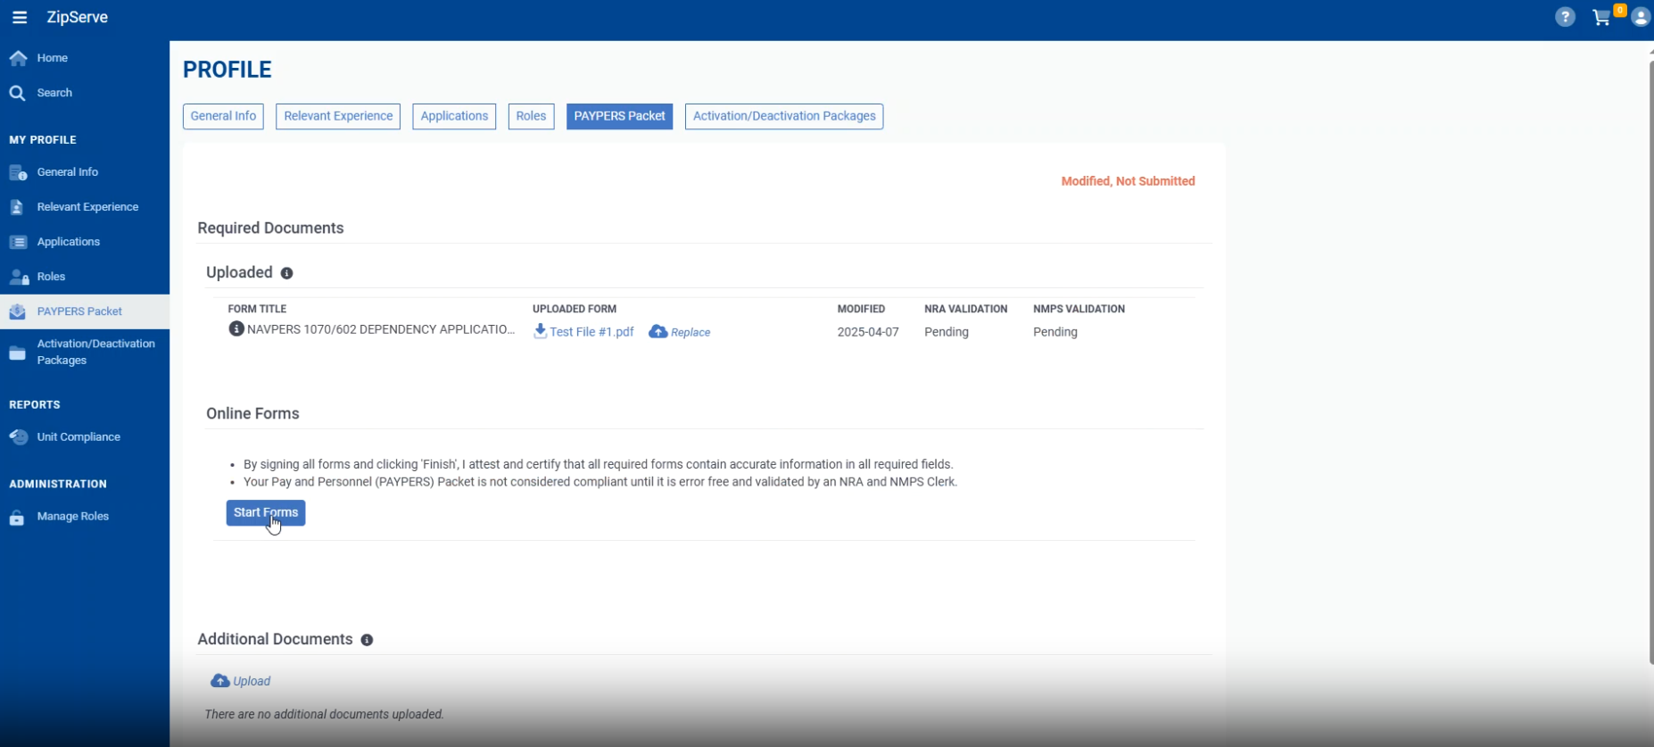
Step 4: Click the ‘Start Forms’ button

Slide 6
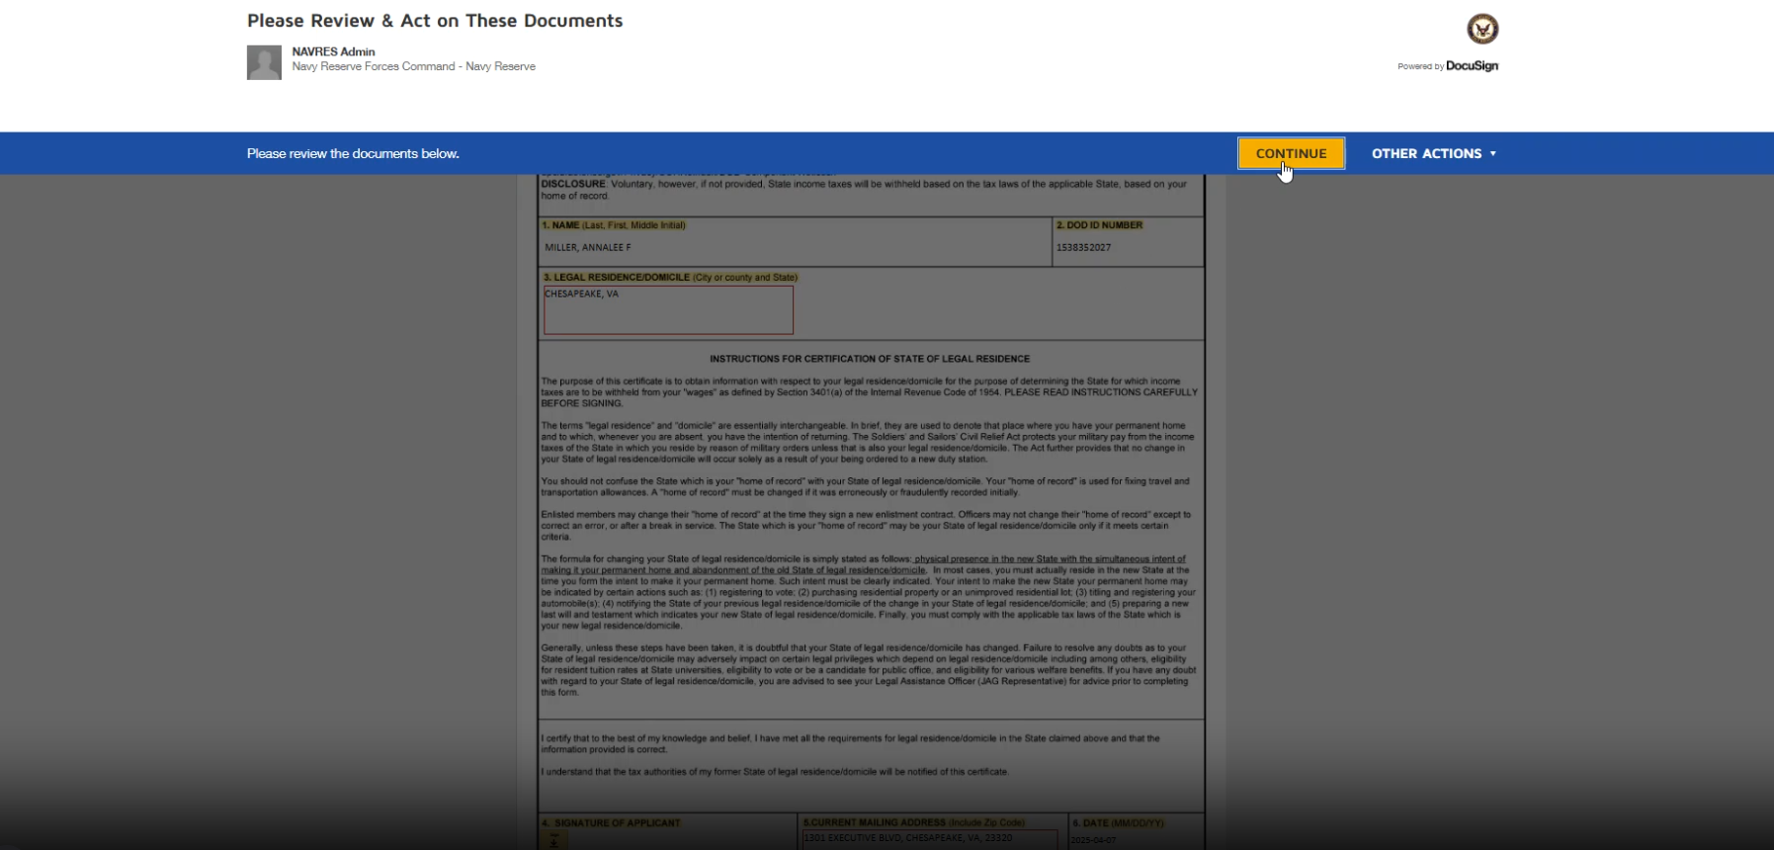
Step 5: Click the ‘CONTINUE’ button

Slide 7
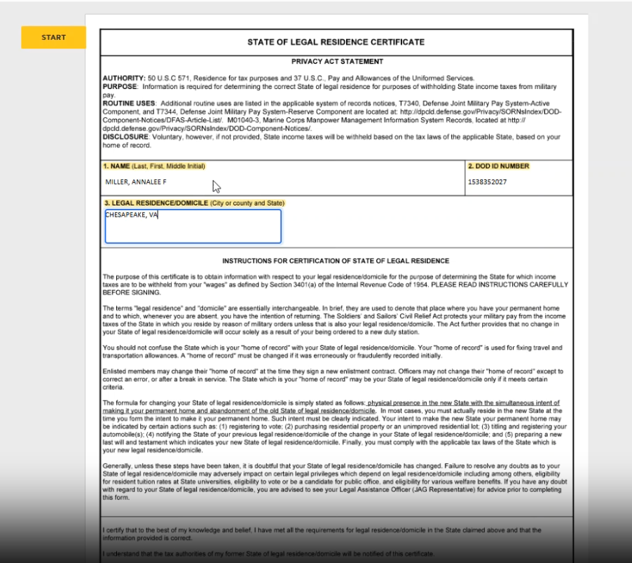
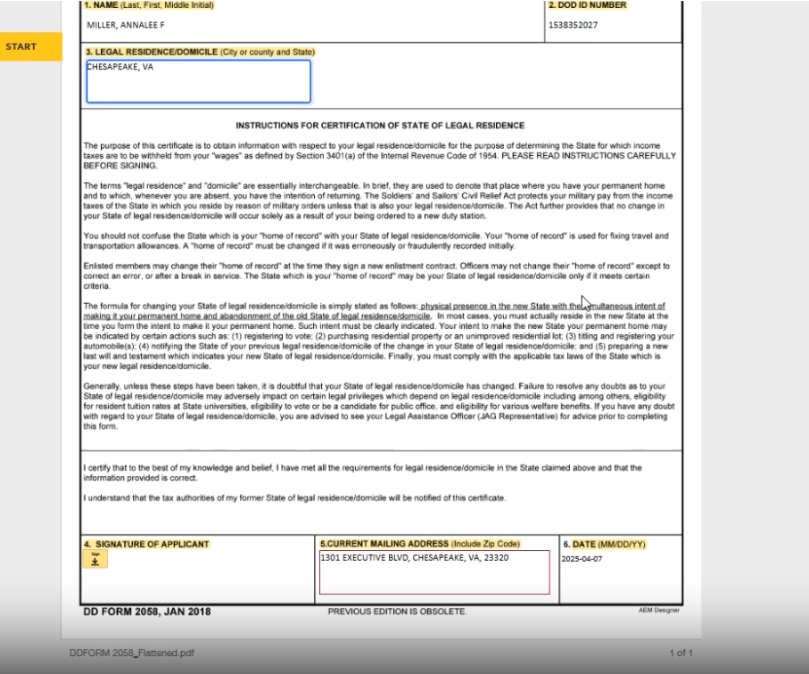
Step 5: Fill out the highlighted portions of the State of Legal Residence Form (DD 2058)

Slide 8
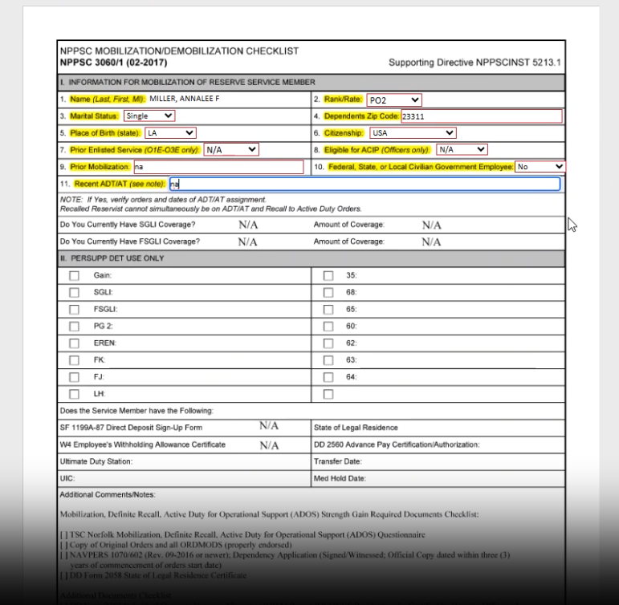

Step 6: Fill out the highlighted portions of the NPPSC Mobilization/Demobilization Checklist

Slide 9
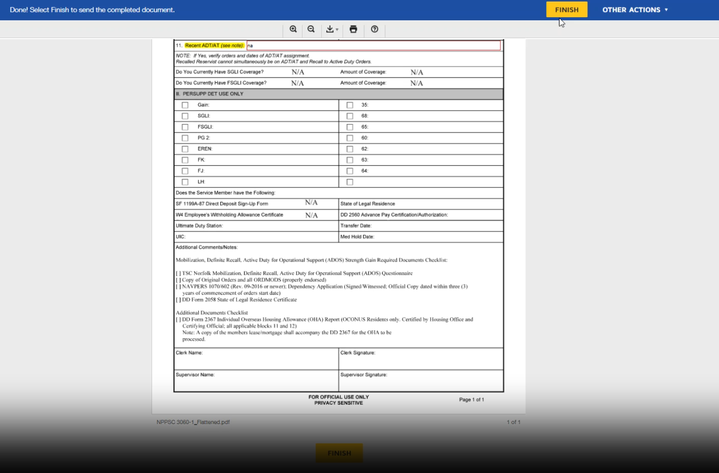
Step 6: Click Finish

